Slide 1

Scientific Communication
Sara Durini - sara.durini@kaust.edu.sa
Faculty Affairs Specialist
Office of the Provost
King Abdullah University of Science and Technology (KAUST)

Slide 2
Scientific communication
Day 1 - Scientific communication
Objective: introduction to scientific communication and its forms
Day 2 - Focus on scientific writing
Objective: how to write scientific texts and reports
Day 3 - Organizing your scientific paper
Objective: how to structure and write scientific papers
Day 4 - Creating your scientific poster
Objective: how to structure and write scientific posters
Day 5 - Communicating your science
Objective: how to present scientific concepts and engage your audience

Slide 3
Organizing your scientific paper
Objective: how to structure and write scientific papers

Slide 4

The Writing Process
Not everyone can write well, but everyone can revise well.
Edit Draft
Write Draft
Organize Ideas
Choose Journal
Analyze Results
Image created from Microsoft Bing © 2023 Microsoft

Slide 5
Structure of a Paper
Abstract
What is the aim and what are the results of your research?
Introduction
What is the context of your research and what challenge does your research address?
Experimental Section
What techniques you used?
Results and Discussion
What do your data say and how did you interpret them?
Conclusion
What is the impact in the field?

Slide 6
An Engaging Abstract
Abstract
STRUCTURE
Intrigue and engage readers
One paragraph
Precise and concise
Context - Thesis - Results - Conclusion
Introduction
STYLE
Concrete subjects and strong verbs
Subject - Verb - Object
Concise sentences and rapid flow
Active verbs, various tenses
Experimental Section
Results and Discussion
Conclusion

Slide 7
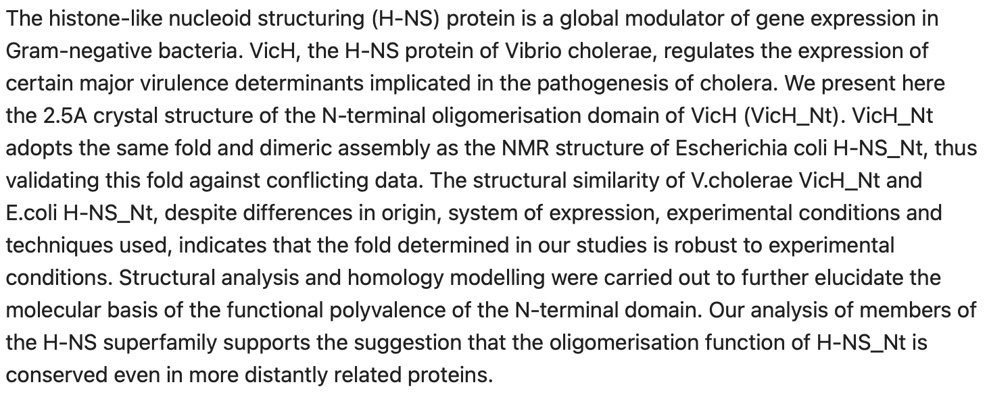
An Engaging Abstract
STRUCTURE
Intrigue and engage readers
One paragraph
Precise and concise
Context - Thesis - Results - Conclusion
STYLE
Concrete subjects and strong verbs
Subject - Verb - Object
Concise sentences and rapid flow
Active verbs, various tenses
Cerdan et al., J. Mol. Biol 2003, 334, 179-185

Slide 8
An Engaging Abstract
STRUCTURE
Intrigue and engage readers
One paragraph
Precise and concise
Context - Thesis - Results - Conclusion
STYLE
Concrete subjects and strong verbs
Subject - Verb - Object
Concise sentences and rapid flow
Active verbs, various tenses
Present – Past Active – Passive
Cerdan et al., J. Mol. Biol 2003, 334, 179-185

Slide 9
An Engaging Abstract
STRUCTURE
Intrigue and engage readers
One paragraph
Precise and concise
Context - Thesis - Results - Conclusion
STYLE
Concrete subjects and strong verbs
Subject - Verb - Object
Concise sentences and rapid flow
Active verbs, various tenses
Present – Past Active – Passive
Cerdan et al., J. Mol. Biol 2003, 334, 179-185

Slide 10
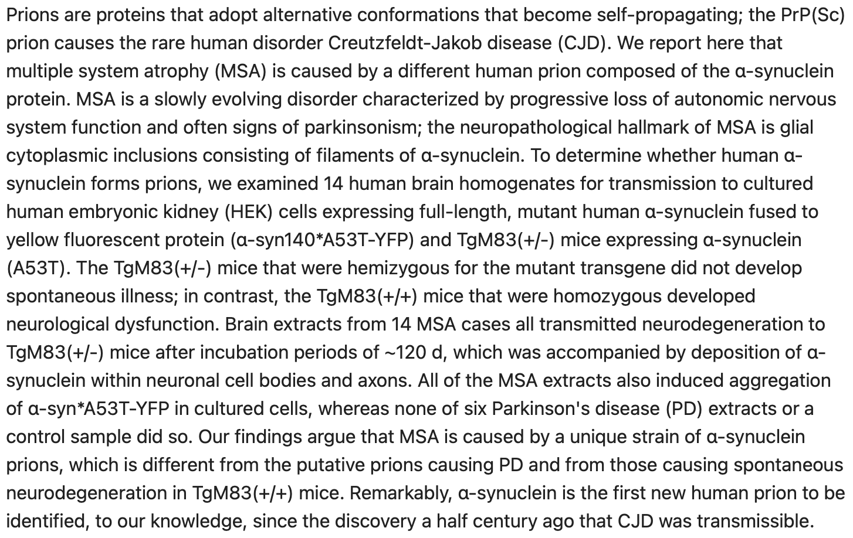
An Engaging Abstract
STRUCTURE
Intrigue and engage readers
One paragraph
Precise and concise
Context - Thesis - Results - Conclusion
STYLE
Concrete subjects and strong verbs
Subject - Verb - Object
Concise sentences and rapid flow
Active verbs, various tenses
Prusiner et al., Proc. Natl. Acad. Sci. USA 2015, 112, E5308-E5317

Slide 11
An Engaging Abstract
STRUCTURE
Intrigue and engage readers
One paragraph
Precise and concise
Context - Thesis - Results - Conclusion
STYLE
Concrete subjects and strong verbs
Subject - Verb - Object
Concise sentences and rapid flow
Active verbs, various tenses
Present – Past Active – Passive
Prusiner et al., Proc. Natl. Acad. Sci. USA 2015, 112, E5308-E5317

Slide 12
An Engaging Abstract
STRUCTURE
Intrigue and engage readers
One paragraph
Precise and concise
Context - Thesis - Results - Conclusion
STYLE
Concrete subjects and strong verbs
Subject - Verb - Object
Concise sentences and rapid flow
Active verbs, various tenses
Present – Past Active – Passive
Prusiner et al., Proc. Natl. Acad. Sci. USA 2015, 112, E5308-E5317

Slide 13
A Focused Introduction
Abstract
STRUCTURE
Give context
Introduce the characters
Challenge
Thesis
Synopsis
COMMON ISSUES
Element missing
Vaguely written
Too long (not a review!)
Paragraphs not linked
Introduction
Experimental Section
Results and Discussion
Conclusion

Slide 14
A Focused Introduction
Abstract
STRUCTURE
Give context
Introduce the characters
Challenge
Thesis
Synopsis
STYLE
Concise language, simple and consistent
Key words
Concrete subjects and strong verbs
Active verbs, various tenses
One paragraph, one main idea
Introduction
Experimental Section
Results and Discussion
Conclusion

Slide 15
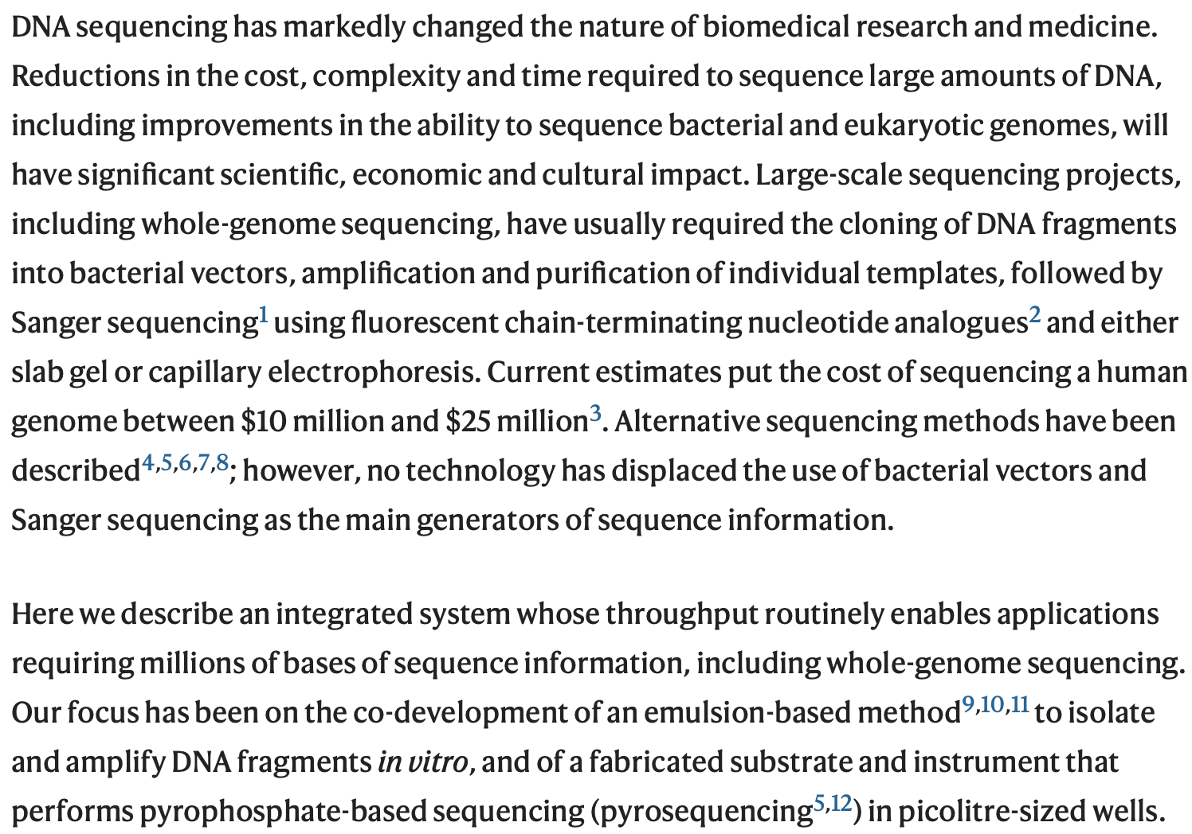
A Focused Introduction
STRUCTURE
Give context
Introduce the characters
Challenge
Thesis
Main results
Margulies et al., Nature 2005, 437, 376-380

Slide 16
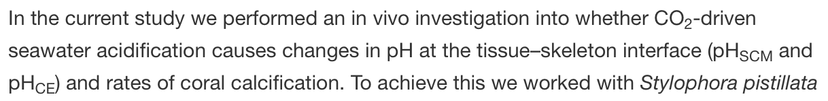
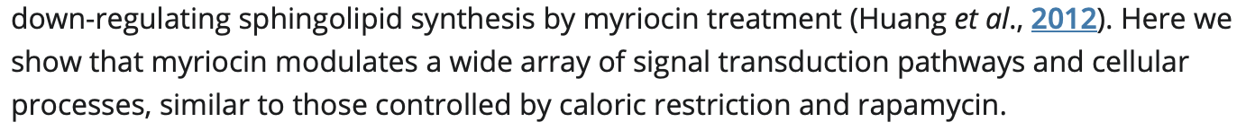
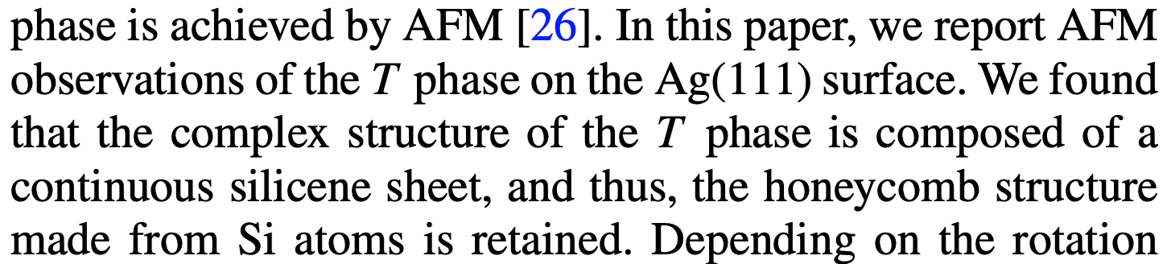
A Focused Introduction
PRESENT YOUR THESIS - EXAMPLES
Wagner et al., Nature 2004, 427, 352-355
Venn et al., Proc. Natl. Acad. Sci. USA 2013, 110, 1634-1639
Liu et al., Aging Cell 2013, 12, 833-841
Onoda et al., Phys. Rev. Mater. 2019, 3, 104002
Adapted from: Lina Mynar, Composition Course Fall 2019: Writing research Articles Effectively for Publication

Slide 17
A Focused Introduction
PRESENT YOUR THESIS - EXAMPLES
Wagner et al., Nature 2004, 427, 352-355
Venn et al., Proc. Natl. Acad. Sci. USA 2013, 110, 1634-1639
Liu et al., Aging Cell 2013, 12, 833-841
Onoda et al., Phys. Rev. Mater. 2019, 3, 104002
Adapted from: Lina Mynar, Composition Course Fall 2019: Writing research Articles Effectively for Publication

Slide 18
A Detailed Experimental Section
1) Draw a house – 1 minute
2) Write the instruction to replicate your drawing – 4 minutes
3) Replicate someone else’s drawing – 4 minutes
4) Compare the drawings
Giving instructions is not an easy task!

Slide 19
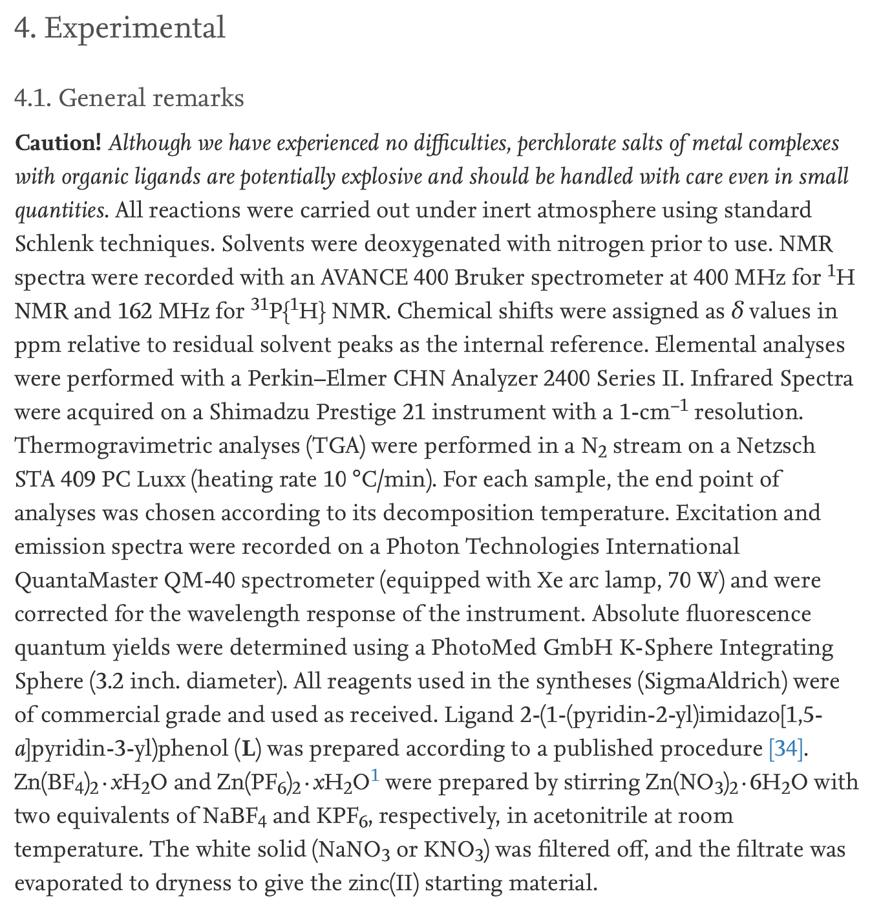
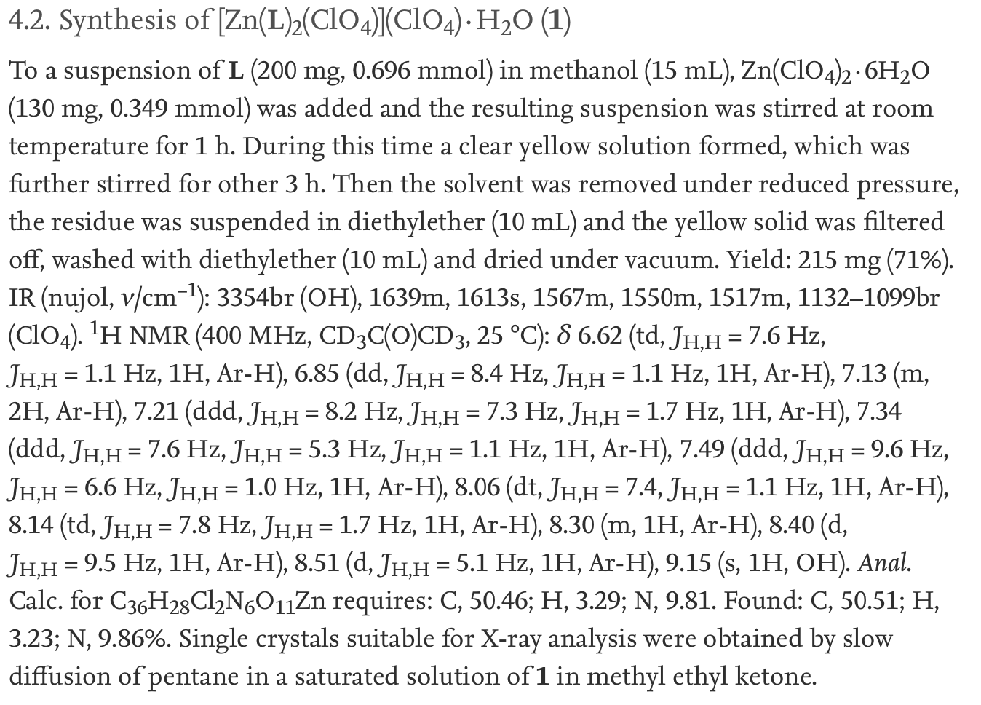
A Detailed Experimental Section
The Materials and Methods section should provide the detail necessary for the reader to replicate the study and to obtain the same results.
STRUCTURE
General overview about methods
Indicate the source of instruments and purchased materials
Indicate where problems can occur
Indicate if extra care is needed
Describe all procedures in detail
STYLE
Keep it simple
Verb: Simple Past Passive
Durini et al., New J. Chem. 2017, 41, 3006-3014

Slide 20
A Convincing Results and Discussion Section
The Results and Discussion section should explain what was obtained by performing the experiments and offer the interpretation of the results.
STRUCTURE
Present the experiments
Interpret the data and convince the readers
Provide context and compare results with those reported in literature
Build arguments
STYLE
Concrete subjects and strong verbs
Organized paragraphs
Connected sections
Active verbs, various tenses

Slide 21
A Convincing Results and Discussion Section
How to organize Paragraphs
Aim: Create a unified story of your research
Connection among sentences in a paragraph
Coherence between paragraphs and sections → logical and smooth transition
Start a paragraph with a Topic Sentence, then add Supporting Sentences
One paragraph, one main idea
Not too long
Tips to revise a paragraph
What is the main point?
What can I use to make the point?
Where do I say it?

Slide 22
A Convincing Results and Discussion Section
How to write Topic Sentences
(In order) To + Verb
1) To confirm this hypothesis, we used atomistic many-body modeling.
2) In order to elucidate crystal orientation of graphene and h-BN, low-energy electron microscopy and low-energy electron diffraction were performed.
Begin with conjunction (Although, When, If, Whereas, Because, After…)
1) Although a number of theoretical, experimental, and computational studies have been devoted to laminar counter-flow flames, only a few studies have addressed the propagation of laminar flames in mixing layers.
2) Because the domain composition of FimW did not provide any functional insights, we reasoned that the chromosomal clustering of fimW with fimX might indicate common functionality.
3) When the linear-response conductance is zero, a finite V can adjust the Fermi energies of the leads relative to the nanocrystal to add or remove an electron to or from the nanocrystal.
Begin with transitional adverbs (However, Thus, Therefore, Because of…)
1) However, the genetic approaches described above could not rule out the possibility that the phenotype that we observed resulted as the levels of expression and/or degradation of the HY₅ protein decreased.
2) Contrary to domestic league rankings, the Fifa/Coca-Cola World Ranking of national soccer teams is intended to rank teams according to their recent performances in international games.
Adapted from: Lina Mynar, Composition Course Fall 2019: Writing research Articles Effectively for Publication

Slide 23
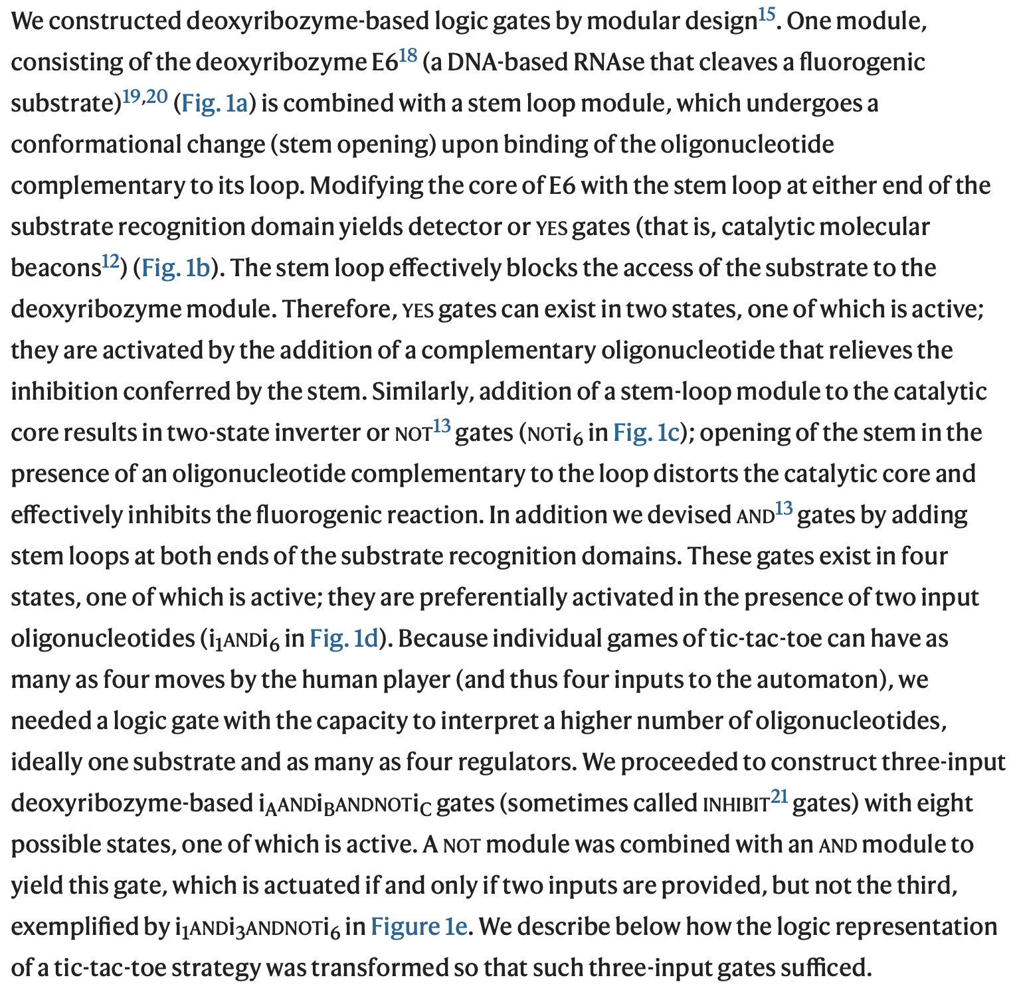
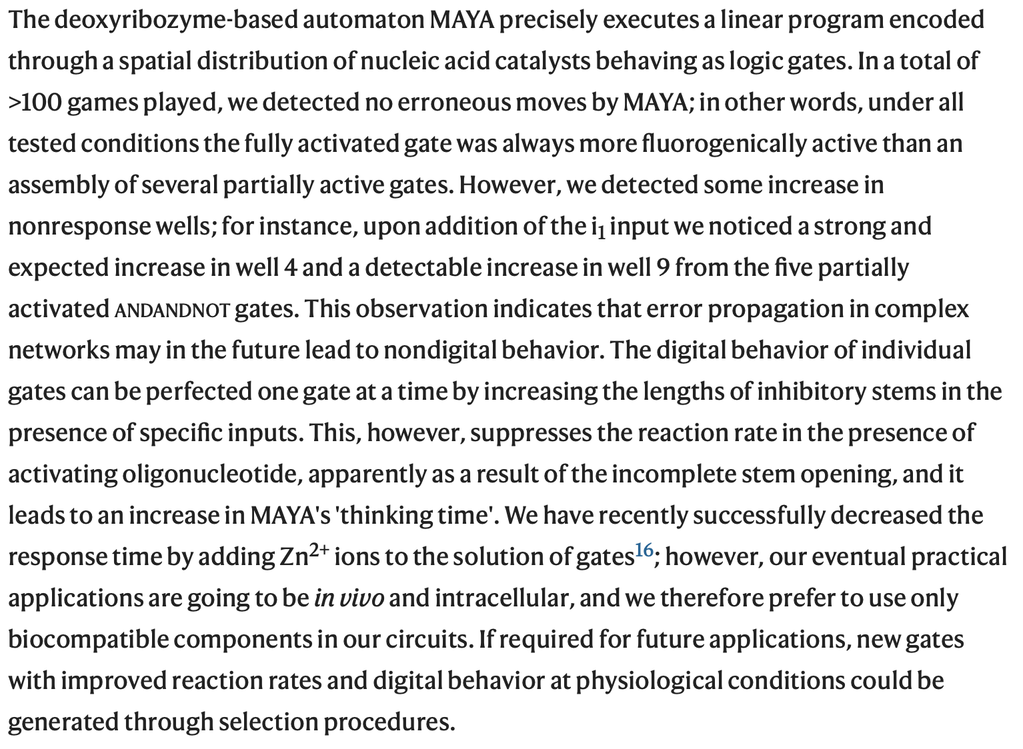
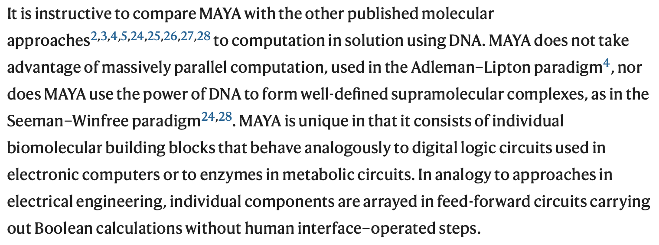
A Convincing Results and Discussion Section
Stojanovic et al., Nat. Biotechnol. 2003, 21, 1069-1074

Slide 24
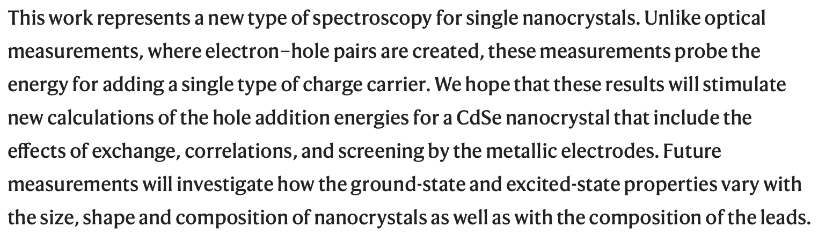
A Meaningful Conclusion
How to close your research story on a high note
STRUCTURE
Remind of the highlights of your research
Argue for your claims
Describe limitations
Contribution to the field
Future developments
Direct and specific
STYLE
Concrete subjects and strong verbs
Subject - Verb - Object
Concise sentences and rapid flow
Active verbs, various tenses
Klein et al., Nature 1997, 389, 699-701

Slide 25
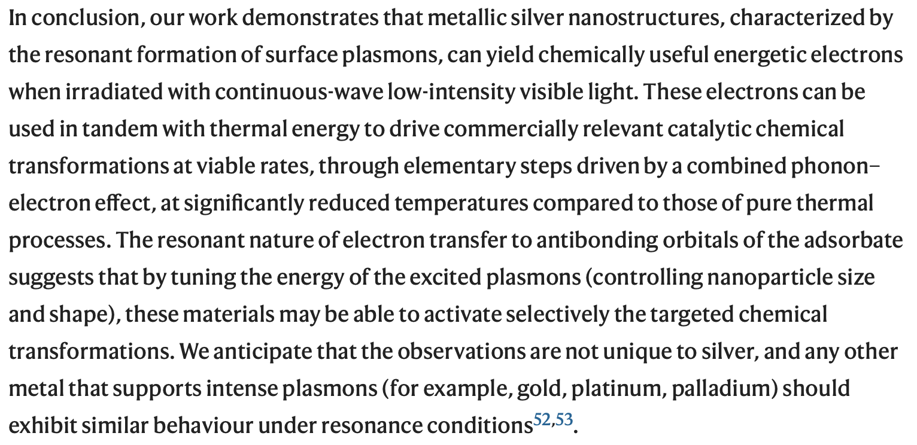
A Meaningful Conclusion
How to close your research story on a high note
STRUCTURE
Remind of the highlights of your research
Argue for your claims
Describe limitations
Contribution to the field
Future developments
Direct and specific
STYLE
Concrete subjects and strong verbs
Subject - Verb - Object
Concise sentences and rapid flow
Active verbs, various tenses
Christopher et al., Nature Chem. 2011, 3, 467-472

Slide 26
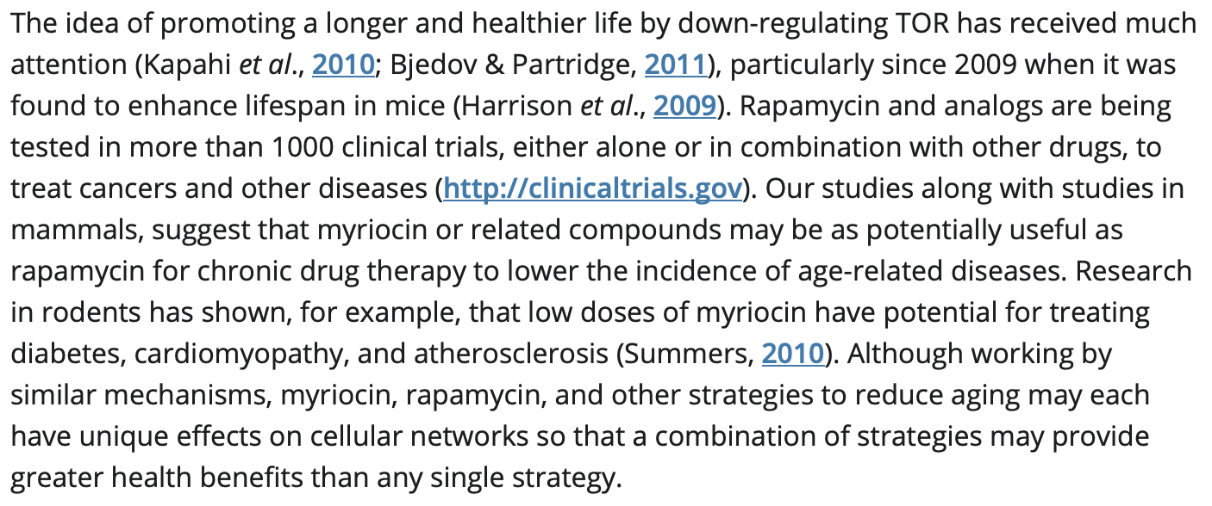
A Meaningful Conclusion
How to close your research story on a high note
STRUCTURE
Remind of the highlights of your research
Argue for your claims
Describe limitations
Contribution to the field
Future developments
Direct and specific
STYLE
Concrete subjects and strong verbs
Subject - Verb - Object
Concise sentences and rapid flow
Active verbs, various tenses
Liu et al., Aging Cell 2013, 12, 833-841

Slide 27
Organizing your scientific paper
Objective: how to structure and write scientific papers

